Slide 1
ENGR-E 503 INTRO TO INTELLIGENT SYSTEMS

Slide 2
DISTRACTED DRIVER DETECTION
BY:
Pranay Reddy Gundala
Srikar Devulapalli
Trevor Peyton
Ruth Balaji

Slide 3
CONTENT
INTRODUCTION
PROBLEM STATEMENT
METHODOLOGY
DATASET
ARCHITECTURE
MODELS
WORKING
RESULTS AND OUTPUTS
CONCLUSION
REFERENCES

Slide 4
INTRODUCTION
Distracted driver detection pertains to the technological advancements and operational mechanisms that are intended to detect and notify drivers who are involved in activities that detract from their primary driving task. Since distracted driving seriously compromises road safety, it is a major global concern. Texting or using a smartphone, eating, adjusting the radio, and engaging in any other activity that diverts the driver's attention from the road are examples of common distractions. In order to address this problem, distracted driver detection systems have been introduced. These systems use cutting-edge technologies to continuously monitor and evaluate driver behavior. To identify indications of distraction, these systems frequently combine sensors, cameras, and artificial intelligence (AI) algorithms.

Slide 5
PROBLEM STATEMENT AND METHODOLOGY
In this project, we developed a Deep Learning Classification model capable of detecting driver behavior from images captured by dashboard cameras in automobiles.
The model indicates whether the driver is:
1. Driving cautiously and paying attention to the road.
2. Using mobile phone.
3. Distracted by doing other activities like operating the radio, drinking etc.
Distracted driving results in numerous collisions, injuries, and fatalities. Our primary objective is to enhance road safety by employing technology to identify drivers who are distracted. To train the model, we provided it with a dataset containing various actions of the driver. After that, we evaluated the application to ensure optimal functionality. If effective, this might help improve road safety and save lives by reducing the occurrence of accidents involving distracted drivers.

Slide 6
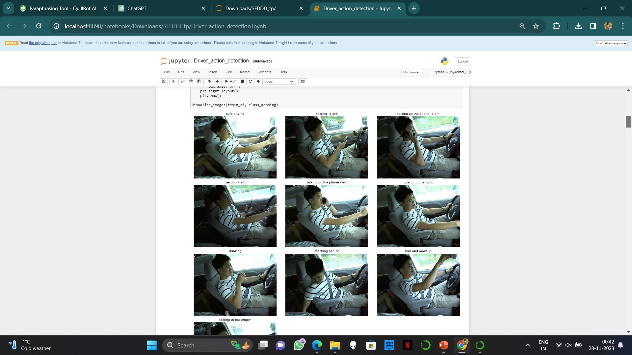
DATASET Sample Input Images

Slide 7
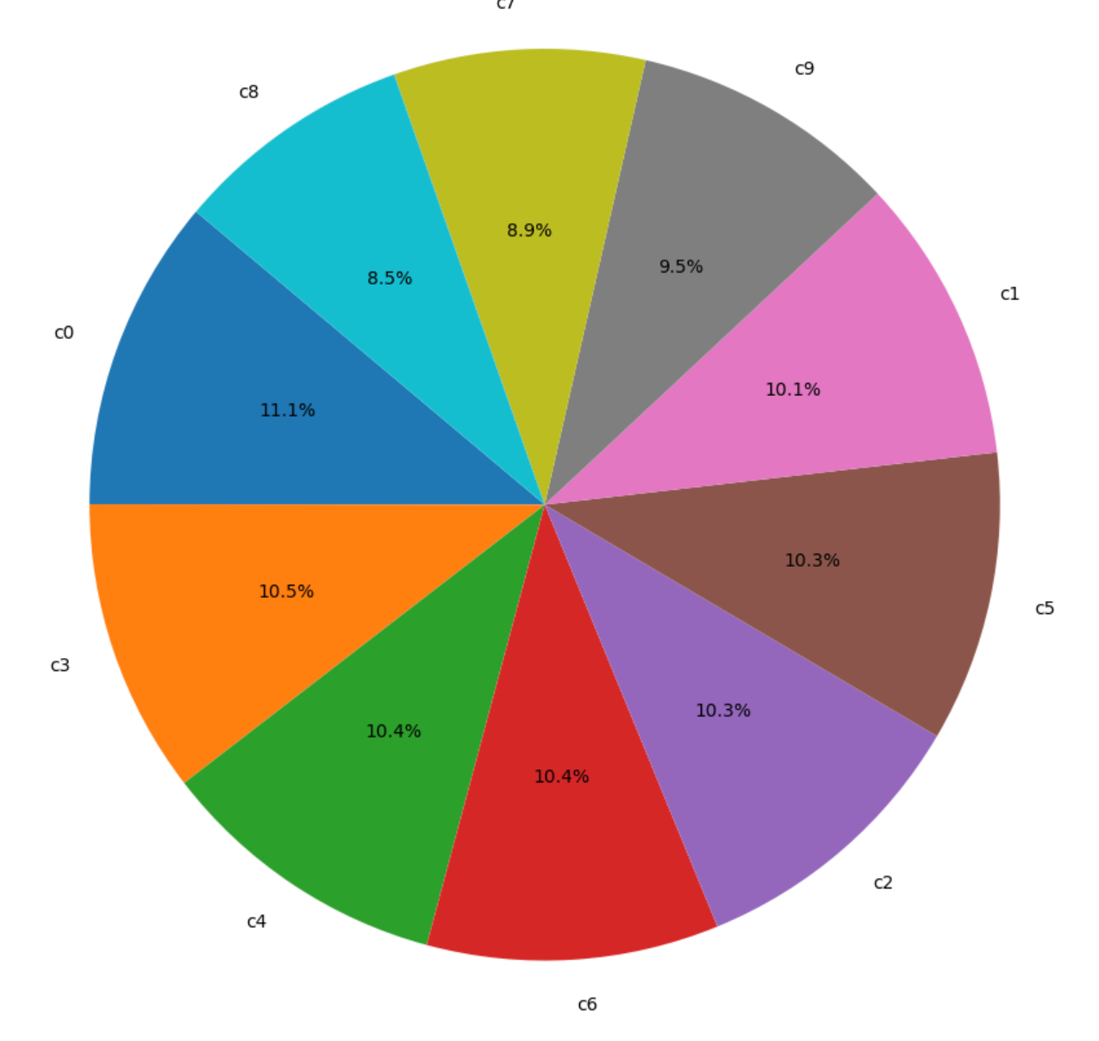
DATASET
CLASS DISTRIBUTION

Slide 8
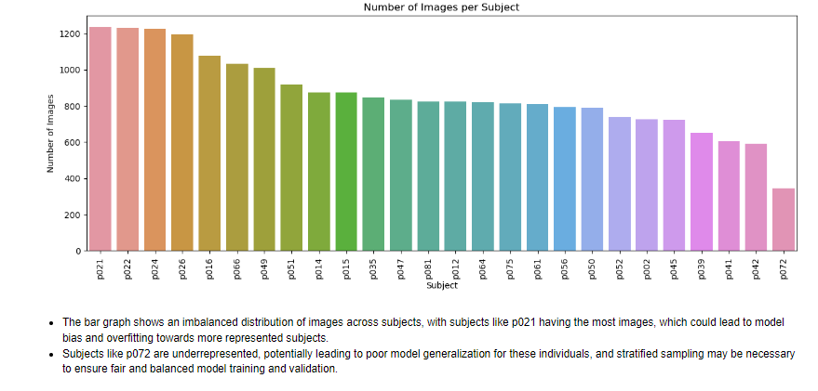
DATASET

Slide 9
ARCHITECTURE
DATA SET
DATA CLEANING
OUTPUT
DATA PREPROCESSING
EVALUATION
MODEL SELECTION & DEVELOPMENT
TRAINING AND VALIDATION
CNN
Mobile net
VGG
Resnet

Slide 10
MODELS
CNN (Base Line) - The Convolutional Neural Network (CNN) baseline model is a fundamental architecture for image processing. It comprises convolutional layers (Conv2D) that extract essential features, such as edges and patterns, from images. MaxPooling layers assist in downsampling and simplifying information, while Fully Connected Layers make decisions based on the extracted features.
MobileNet - MobileNet is a lightweight deep learning model designed for mobile and edge devices. It features depth-wise separable convolutions, where standard convolutions are split into depth-wise and point-wise convolutions. This architecture reduces computational complexity while maintaining accuracy, making it suitable for resource-constrained environments.
ResNet - Residual Networks (ResNet) are known for introducing residual learning, addressing the vanishing gradient problem in deep neural networks. It utilizes residual blocks, allowing the model to skip connections and learn residual functions. This architecture facilitates the training of very deep networks, promoting better feature extraction and representation.
VGG - The Visual Geometry Group (VGG) architecture is characterized by its simplicity and uniform structure. It consists of repeated blocks of convolutional layers with small 3x3 filters, ReLU activations, and max pooling. This straightforward design facilitates understanding and implementation, making it a popular choice for image classification tasks.

Slide 11
WORKING
In this project, we developed a model to examine images captured by dashboard cameras in cars. Several layers enable the baseline model to learn from the images including:
1.Convolutional Layers (Conv2D)
2. MaxPooling Layers
3. Fully Connected Layers
Other operations like 'Dropout' (to prevent overfitting), 'Softmax' (to turn the model's output into probabilities), and 'Activation' (to provide some non-linearity to the model) have also been utilized.
Next, to determine how the baseline model would perform against state-of-the-art models, we experimented with several popular pretrained models, including MobileNet, VGG, and ResNet.
Each pretrained model had weights that had been previously learned on the ImageNet dataset loaded in. This is called transfer learning. The Final layer was substituted with a new dense layer that had 10 output neurons, matching the number of classes in our group. Only this newly added layer was used for training, making use of the features that were acquired from ImageNet.
In the end, our model was able to determine whether the driver is safe, buckled up, or preoccupied by examining images from the dashboard camera. This lowers the number of distracted driving-related accidents, which benefits both auto insurance and road safety.

Slide 12
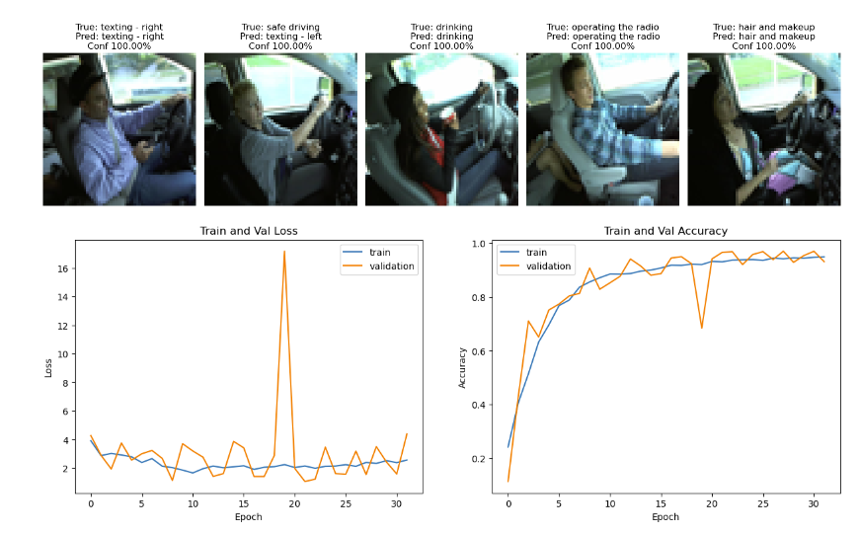
CNN(Baseline)
Test Accuracy – 96.66%

Slide 13
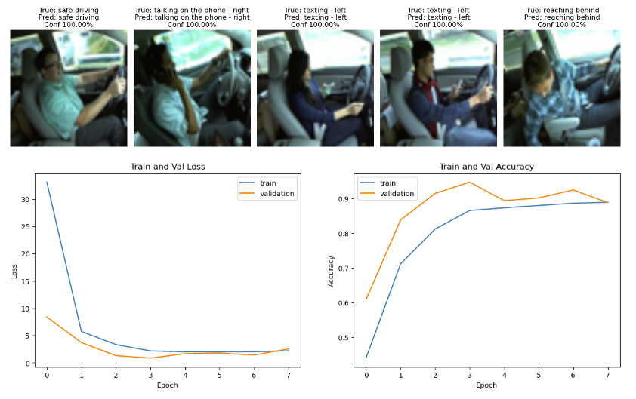
MOBILENET
Test Accuracy – 94.38%

Slide 14
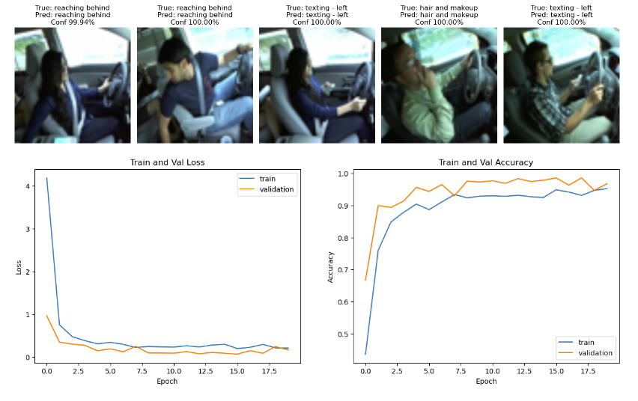
VGG16
Test Accuracy – 98.17%

Slide 15
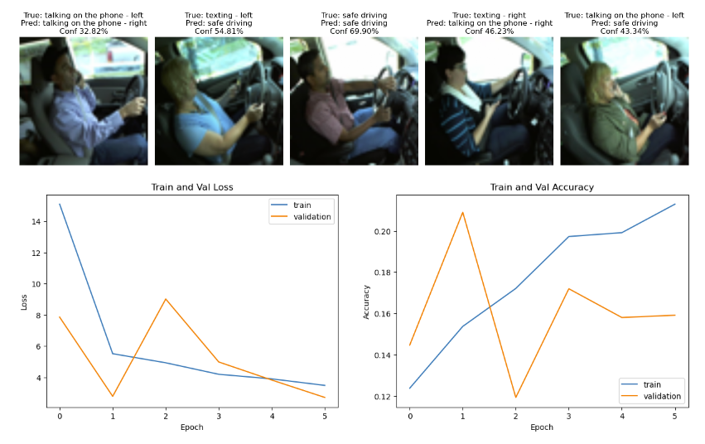
RESNET50
Test Accuracy – 21.45%

Slide 16
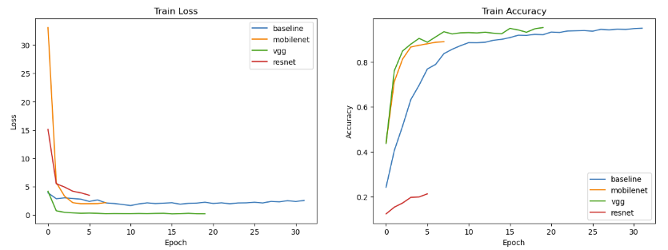
RESULTS AND OUTPUTS

Slide 17
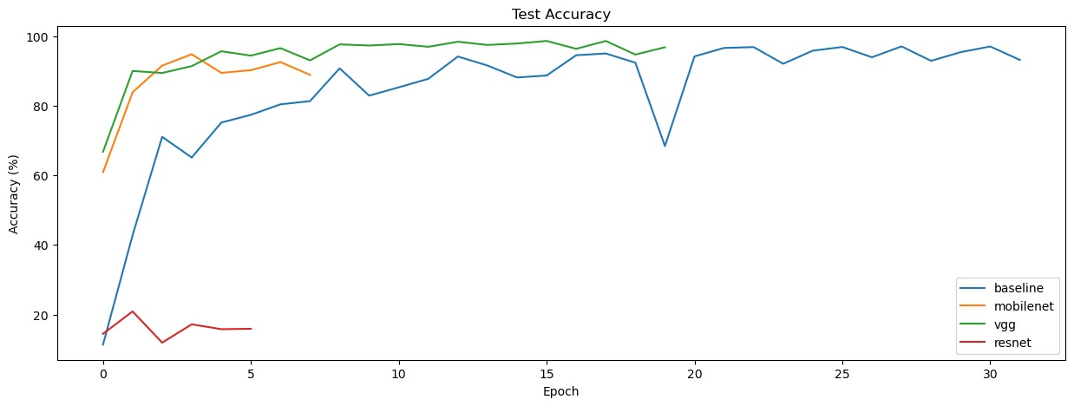
RESULTS AND OUTPUTS

Slide 18
CONCLUSION
In conclusion, the project produced the desired outcome, and the machine learning model's implementation offered us a comparatively high level of accuracy on the test dataset.
In the end, almost all models performed with a high degree of accuracy except for ResNet. It appears that the ResNet had too many features and might have required a different training regimen or training from scratch.
The biggest difference in models then was time. Although VGG produces significantly better outcomes than our baseline, the training and inference times are much longer. The model you choose would rely on the amount of time and computing availability.

Slide 19
REFERENCES
https://www.kaggle.com/c/state-farm-distracted-driver-detection
https://www.kaggle.com/code/araspirbadian/distracted-driver-detection
https://www.kaggle.com/code/ismailchaida/cnn-to-detect-driver-actions
https://www.kaggle.com/code/kaustubhshirpurkar/distracted-driver-detection

